Slide 1
Community Service Project

Slide 2

Internet Usage In Village

Slide 3

Mentor: Mrs. J. Divya Lalitha Sri
M. Tech(Ph. D.), Assistant Professor
Team Members :
Abir Basak -21P31A0568
Akshat Kumar Sinha - 21P31A0570
Amir Hamza - 21P31A0571
Bibhab Das - 21P31A0575
Dwipendu Kundu - 21P31A0581
Kunal Kanti Saha - 21P31A0594
Sheik Rizwan - 21P31A05B5
Narni Sai Jeevan - 21P31A0557
Abhishek Kumar - 21P31A0567

Slide 4
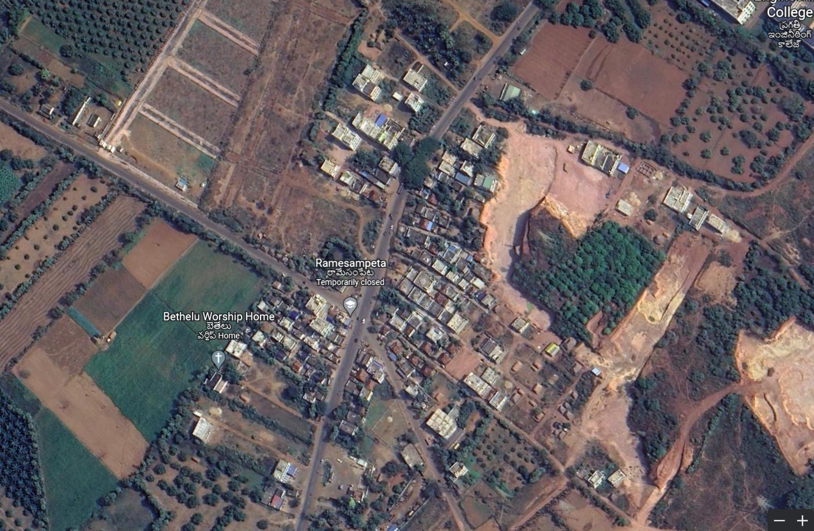
Introduction to the village
Ramesampeta is a village is 2.9 km near to Surampalem.
The total population of this village is about 1218 .
Males are 600.
Females are 618.
There are 306 houses.
Literacy Rate – 76.14%
Total area of this village is 313 Hectares.

Slide 5
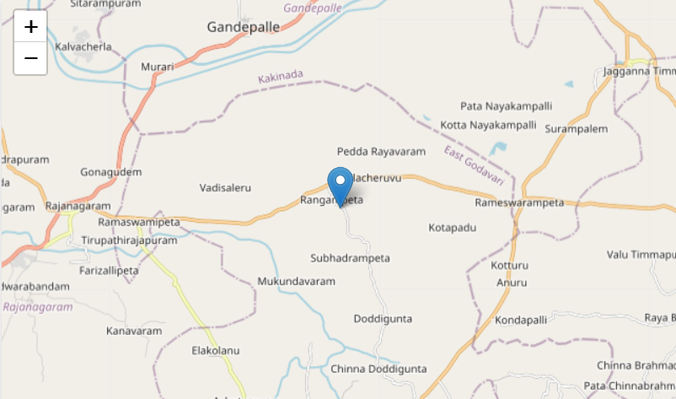
Location to the village
Ramesampeta Geographical details:
Longitude: 81.988930 East
Latitude : 17.081636 North
District: East Godavari
State: Andhra Pradesh
Country: India
Why Ramesampeta?
Ramesampeta is a rural area.
People have lack of knowledge about internet usage.
To spread awareness among the people.

Slide 6
Introduction to the project
Our project is about Internet usage in a village.
We have taken the surveys from the villagers about their knowledge on the internet and tried to make them aware about
What is internet ?
Why it is important ?
What are the usage while surfing though internet ,etc. ?
And also to know what are issues they are facing while using the internet.

Slide 7
Internet
Internet is the collection of millions of computers around the world that are well connected to one another.
It is a Global network of computers.
ARPANET in the year 1969.
The www opened to the public in 1991.
The internet was first launched in 1995 in India.

Slide 8
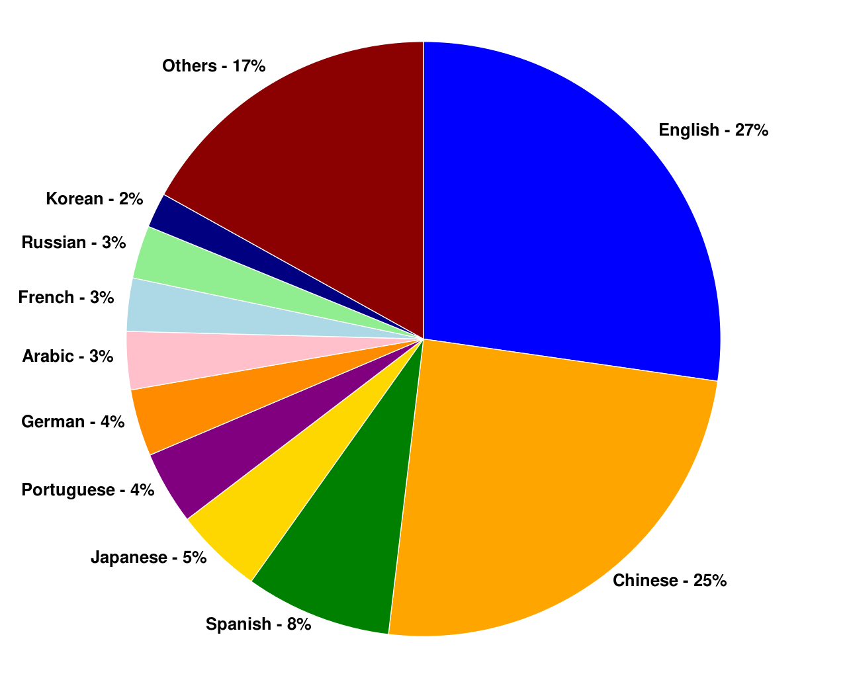
Here is the usage of internet by language :

Slide 9

Survey
We take survey from the peoples of Ramesampeta to gather information.
We take these survey in Google-form.
Due to Google-form it takes lesser time to take the survey.

Slide 10
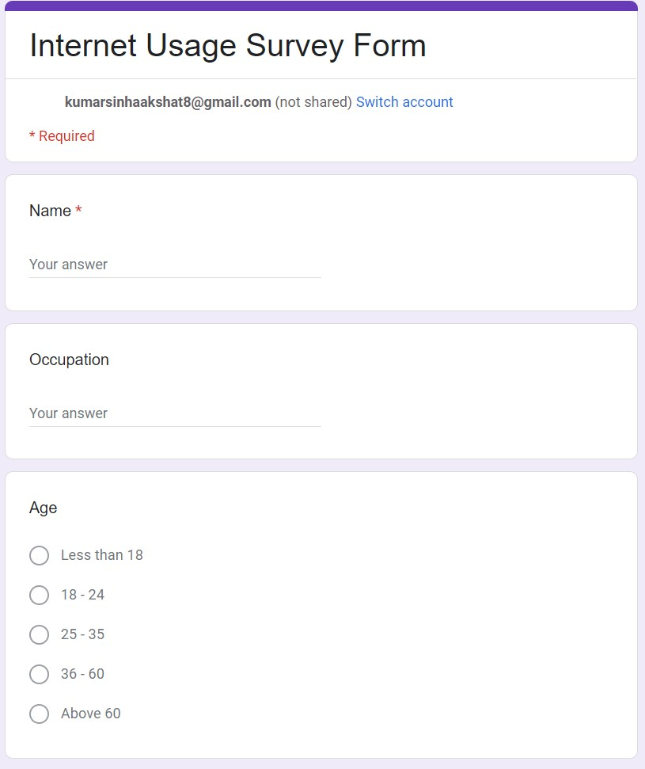
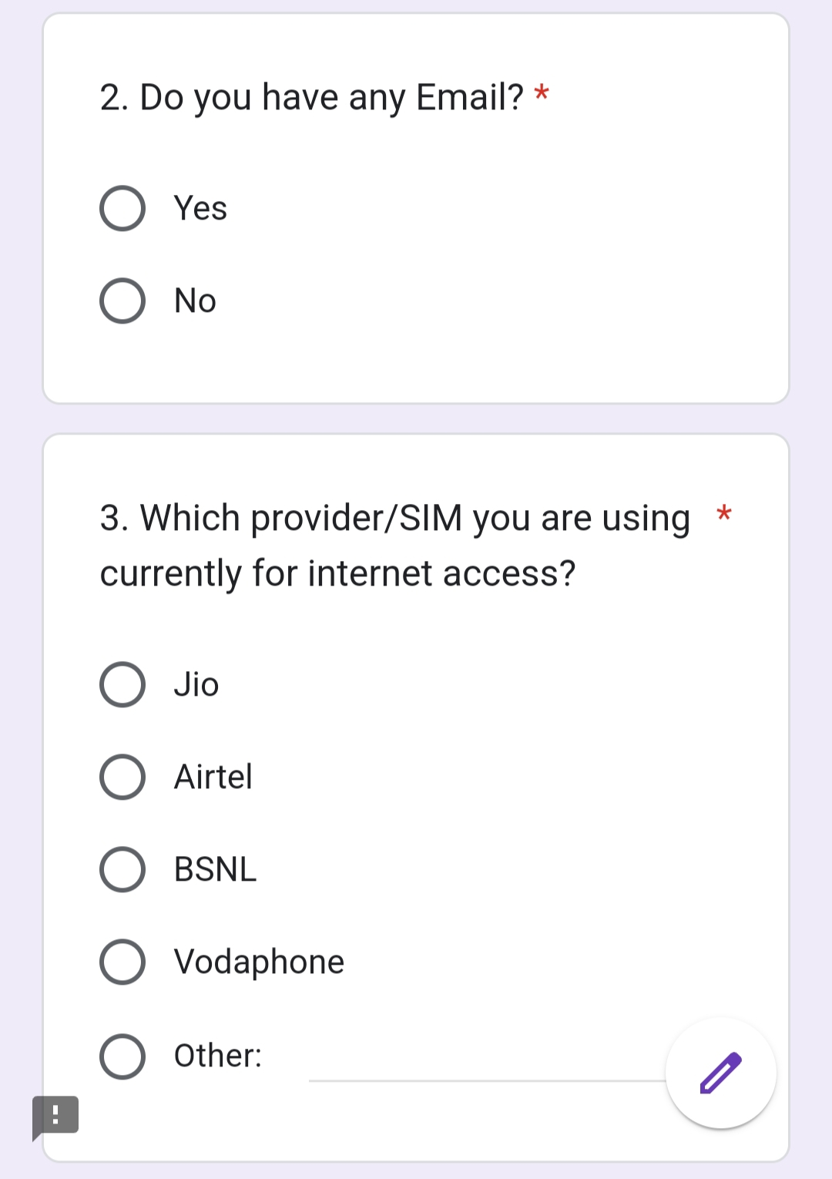
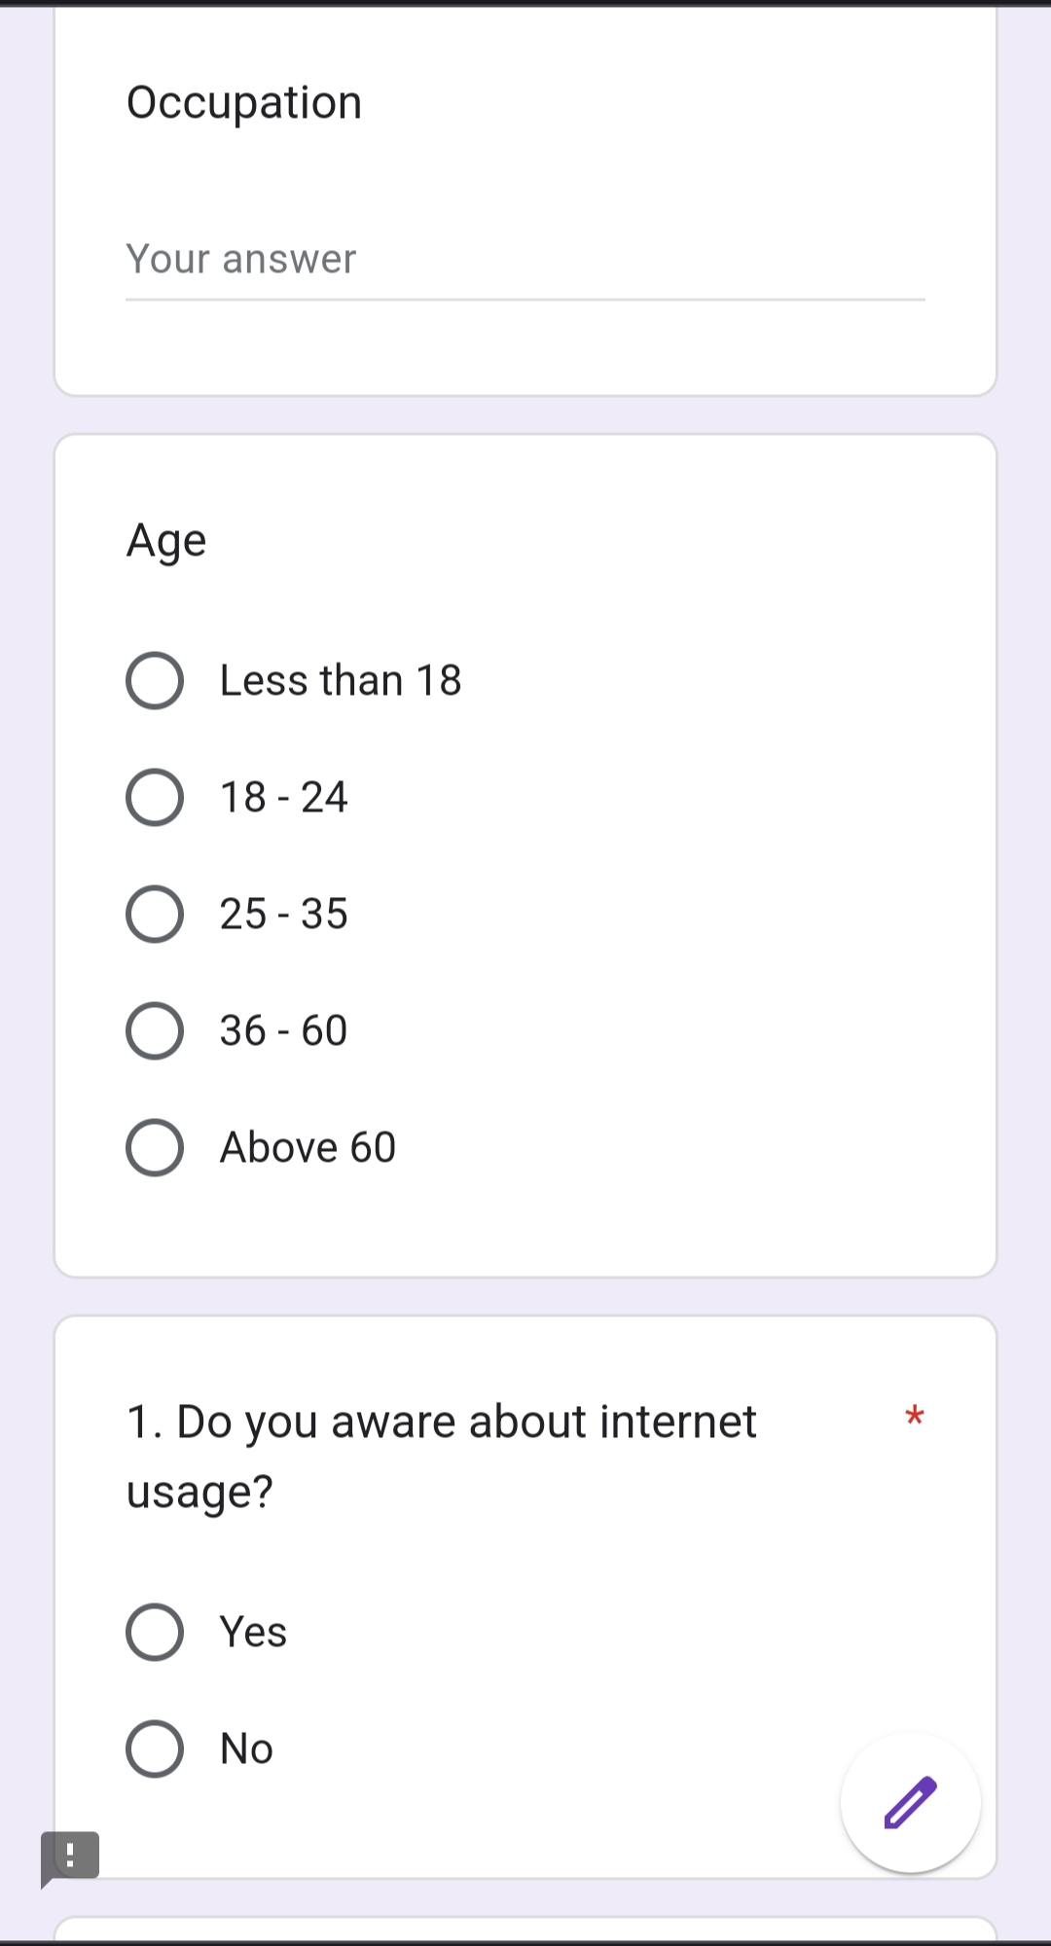
SURVEY FORM QUESTIONS:-

Slide 11
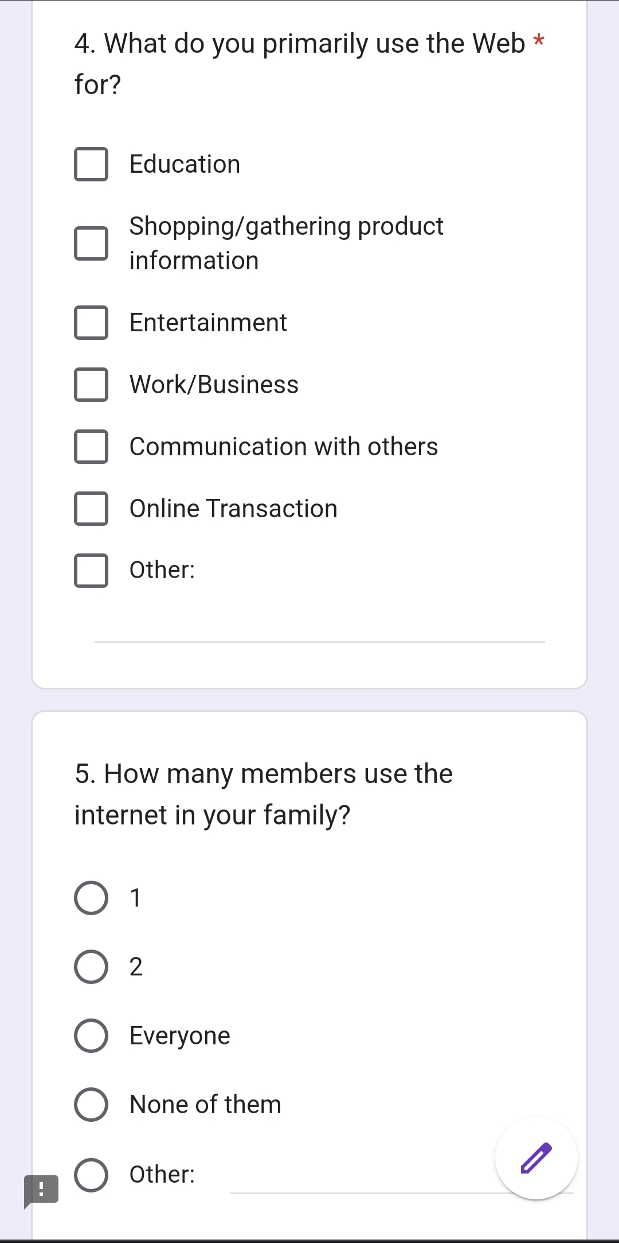
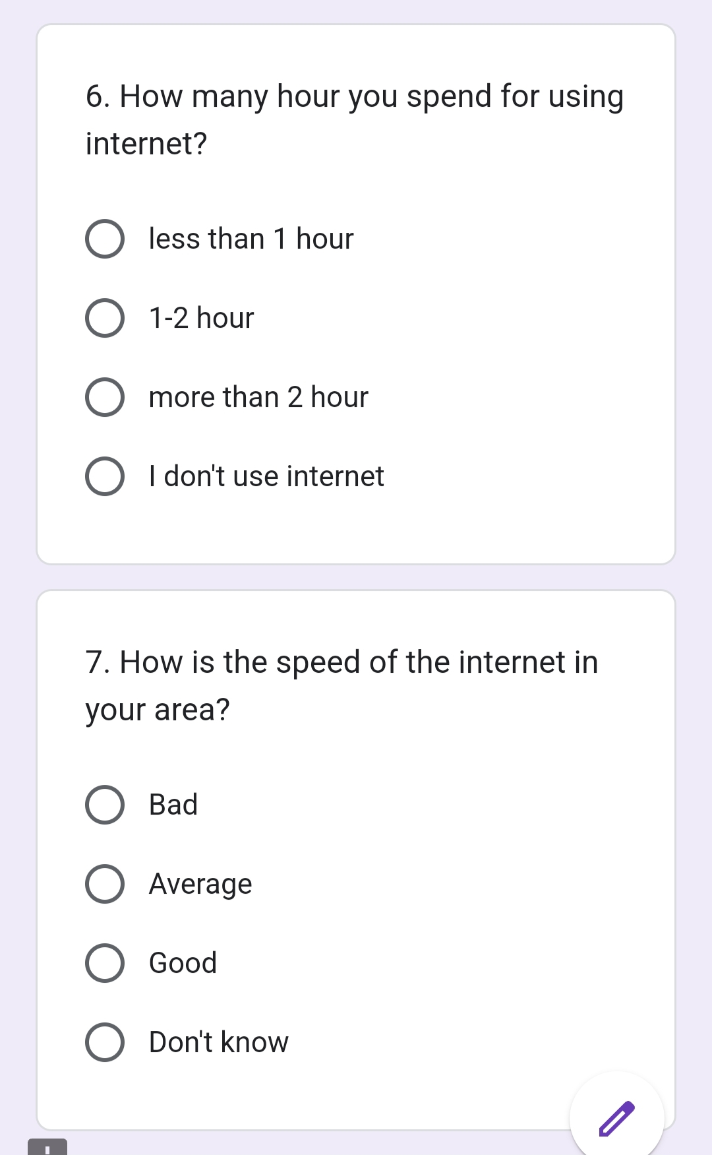

Slide 12
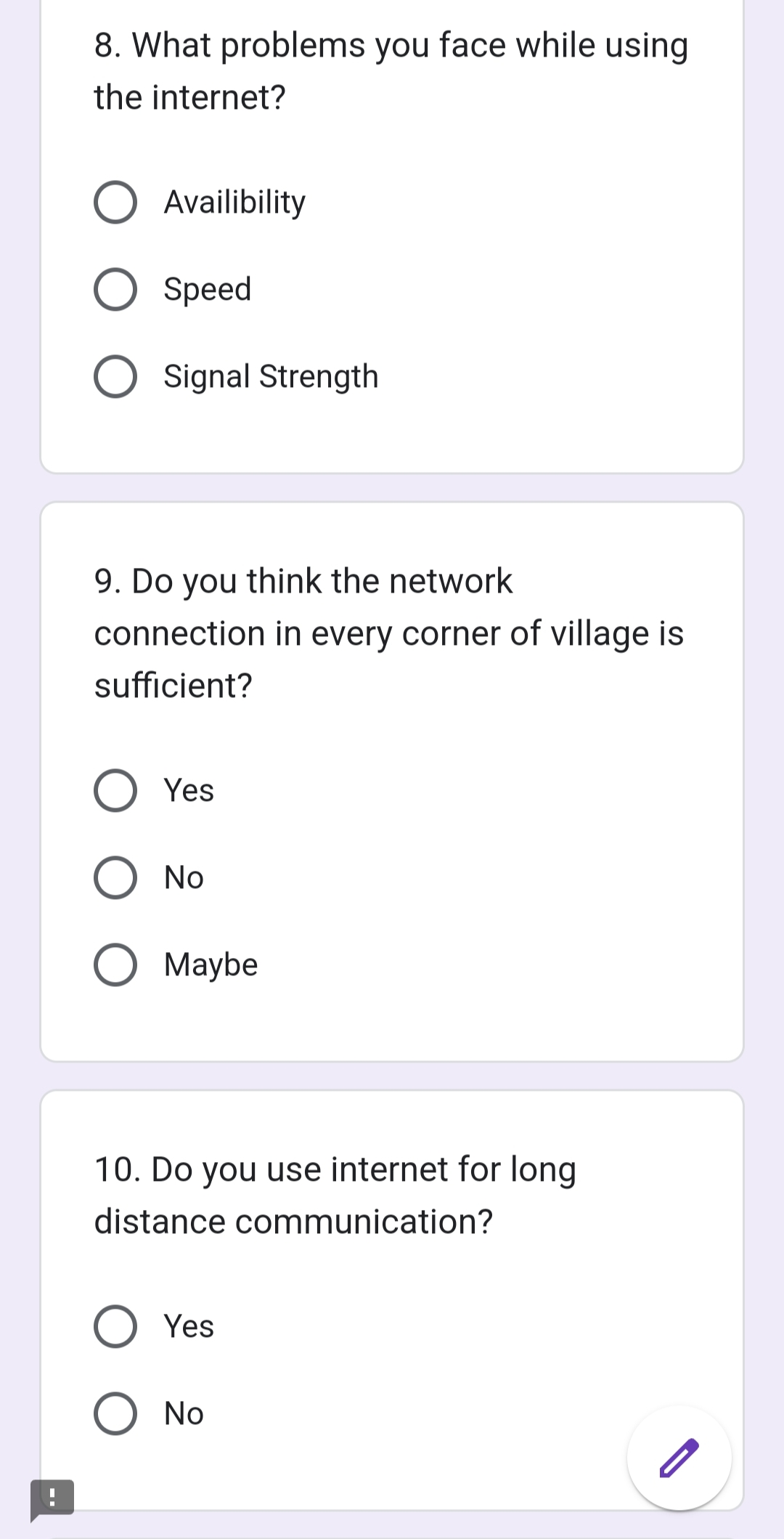
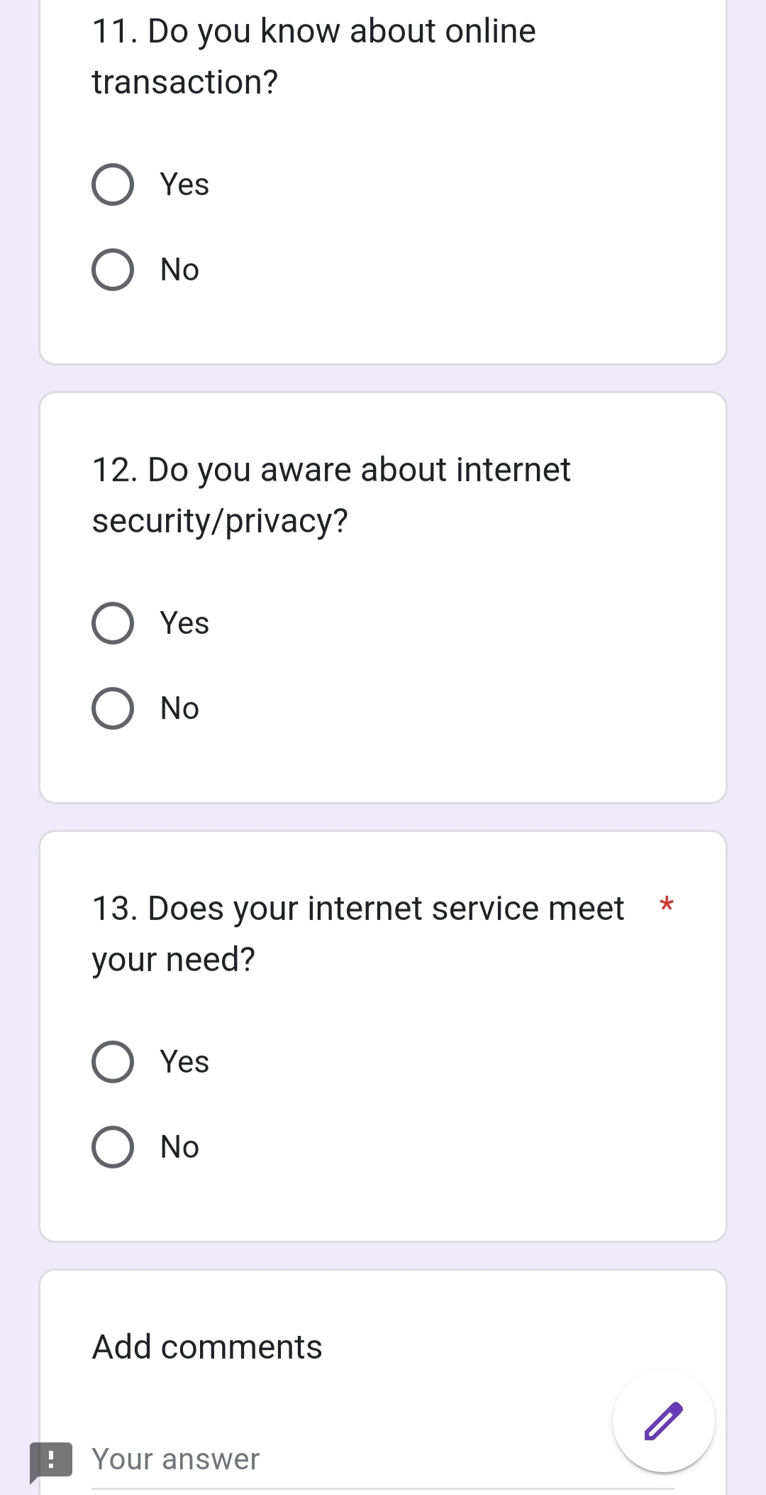

Slide 13
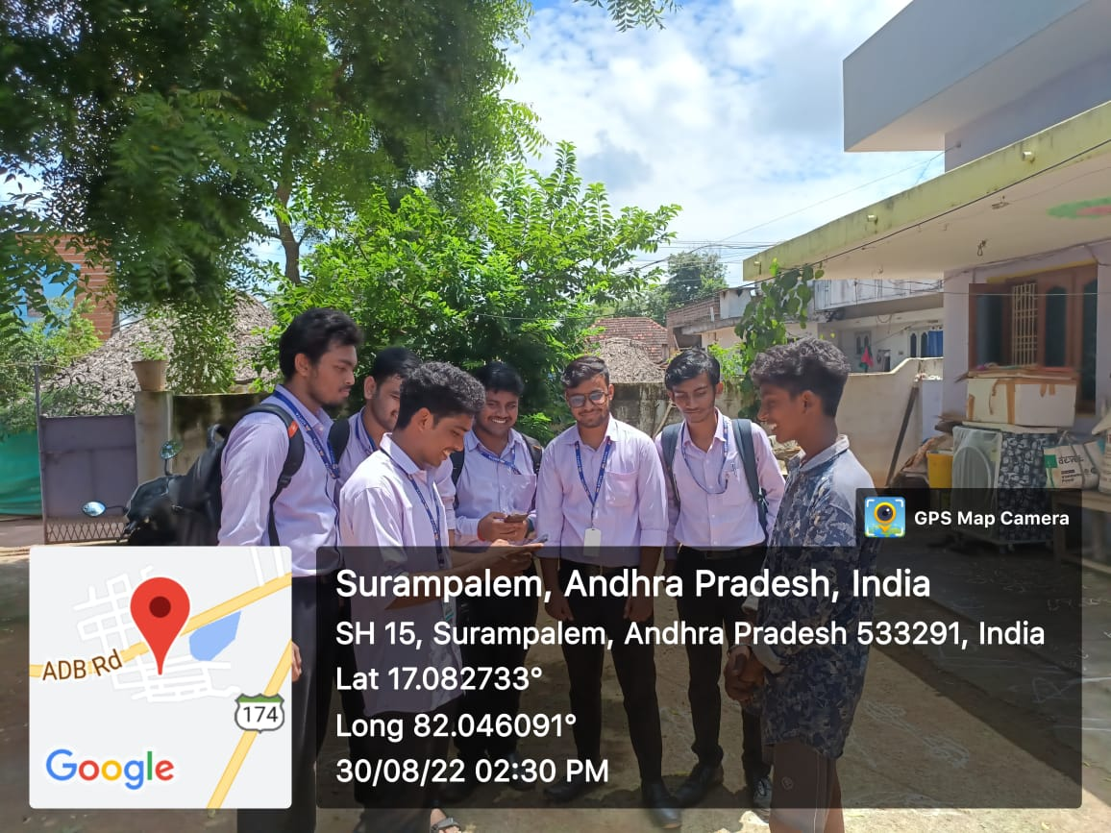
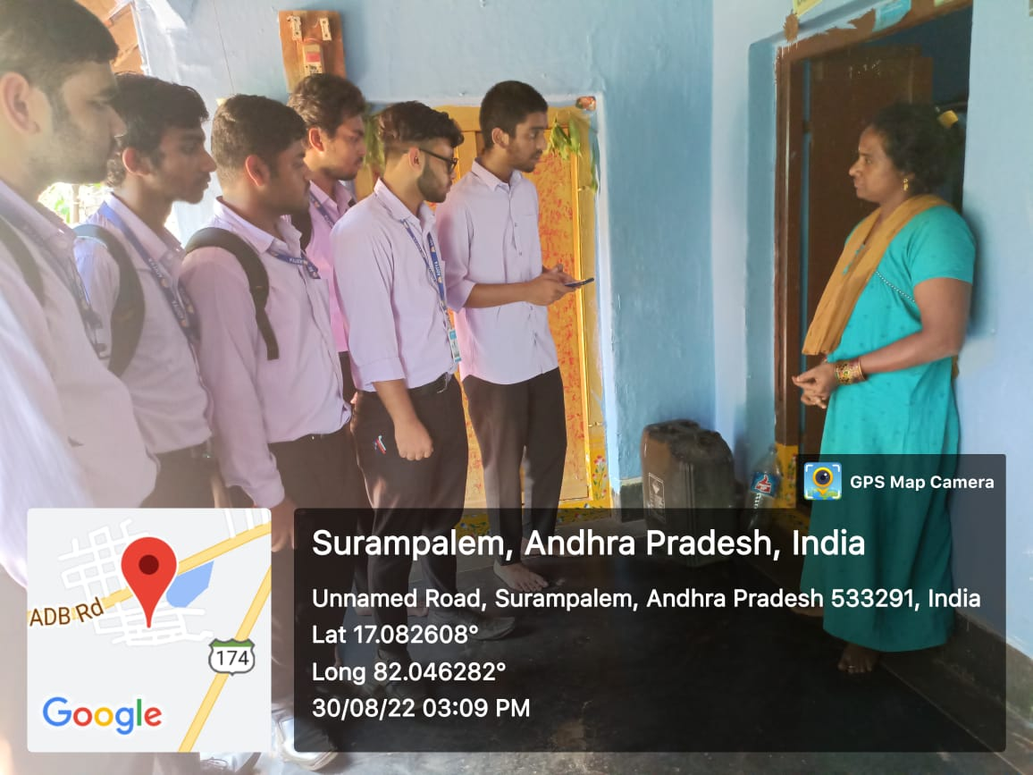
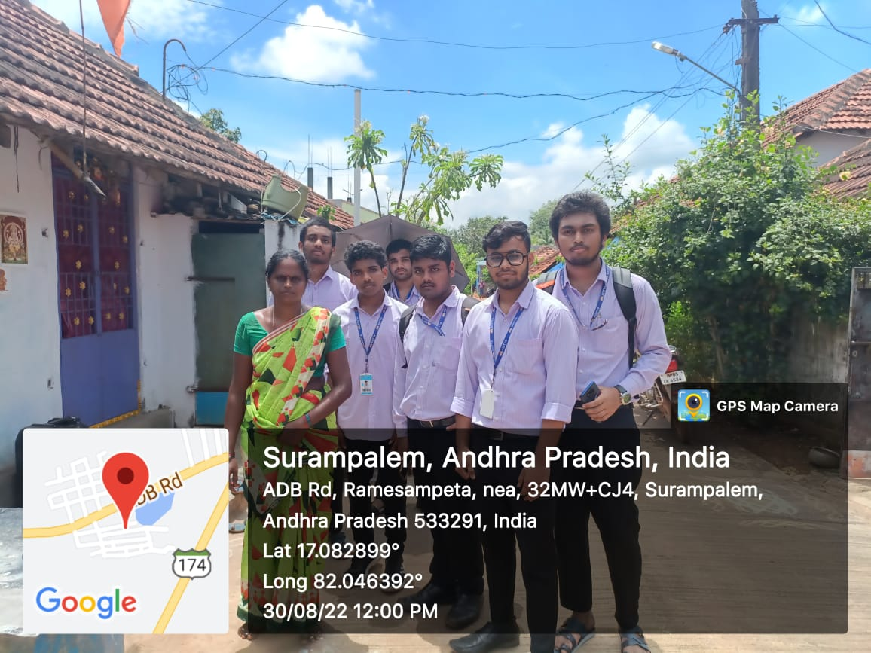
Pictures of Survey
Day-1
Date-29/08/22
Visited 4 houses from 10:00AM to 12:30PM
Visited 6 houses from 02:00PM to 04:30PM

Slide 14
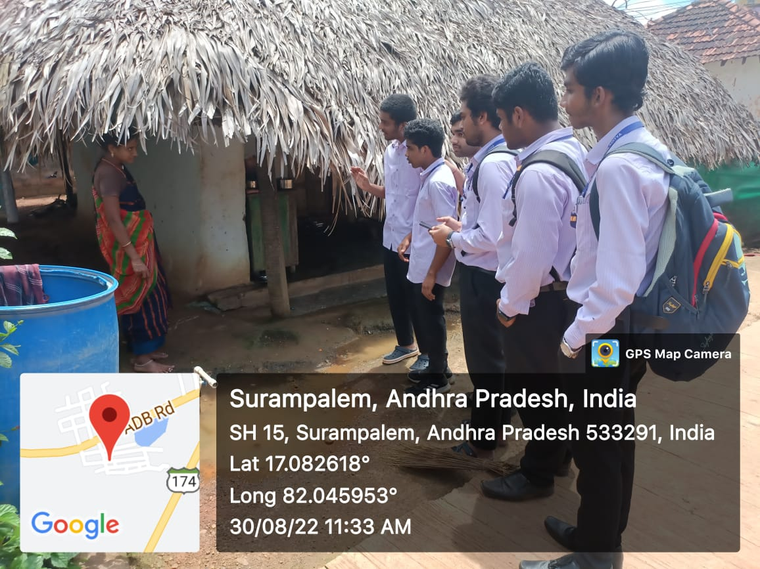
Date-29/08/22

Slide 15
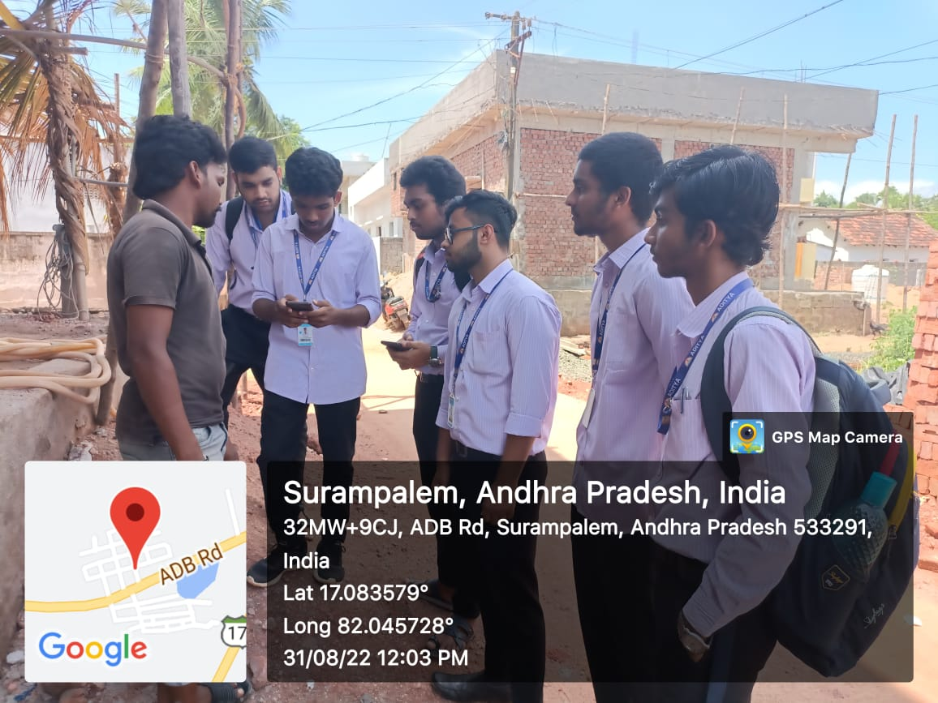
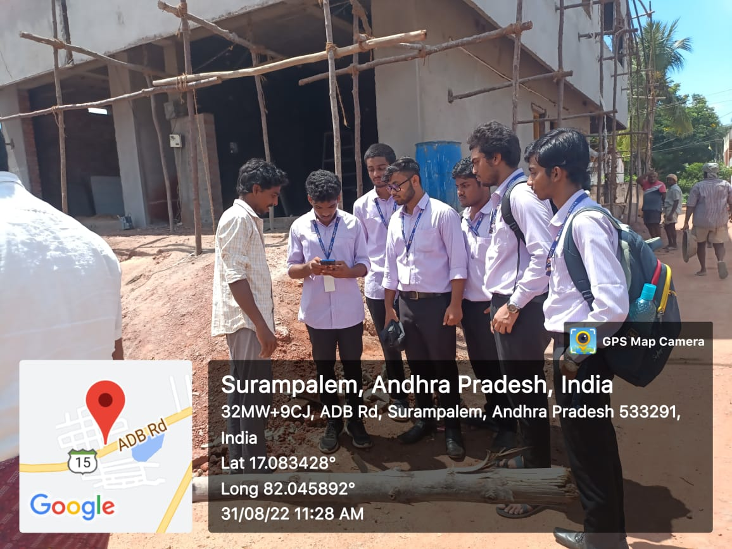
Day-2
Date-30/08/22
Visited 10 houses from 10:00AM to 12:30PM
Visited 10 houses from 2:00PM to 04:30PM

Slide 16
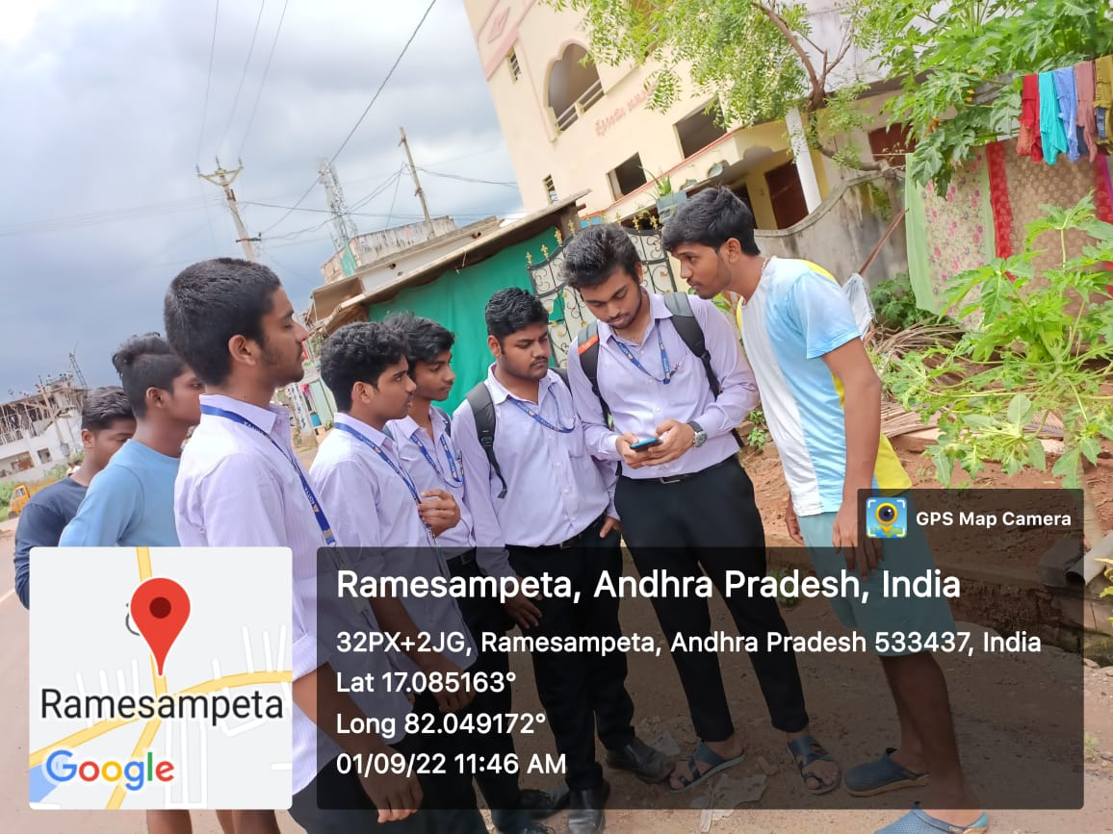
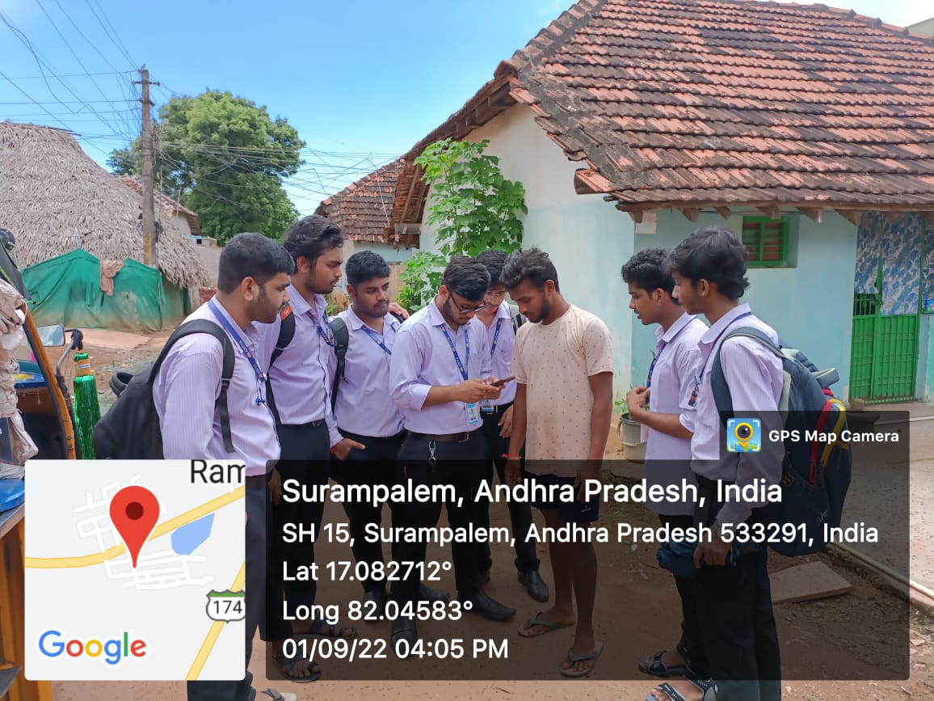
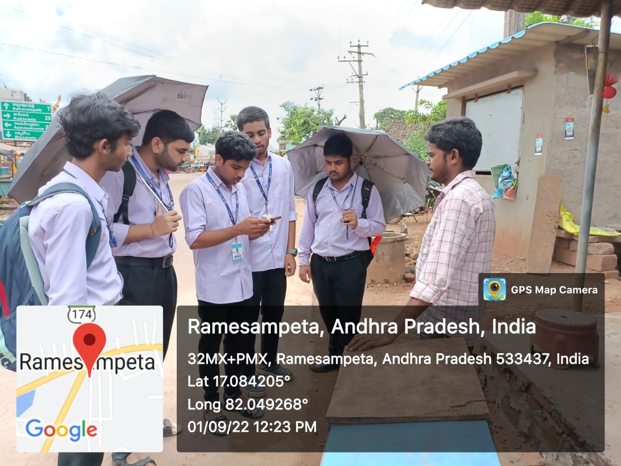
Day-3
Date-01/09/22
Visited 9 houses from 10:00AM to 12:30PM
Visited 10 houses from 02:00PM to 04:30PM

Slide 17
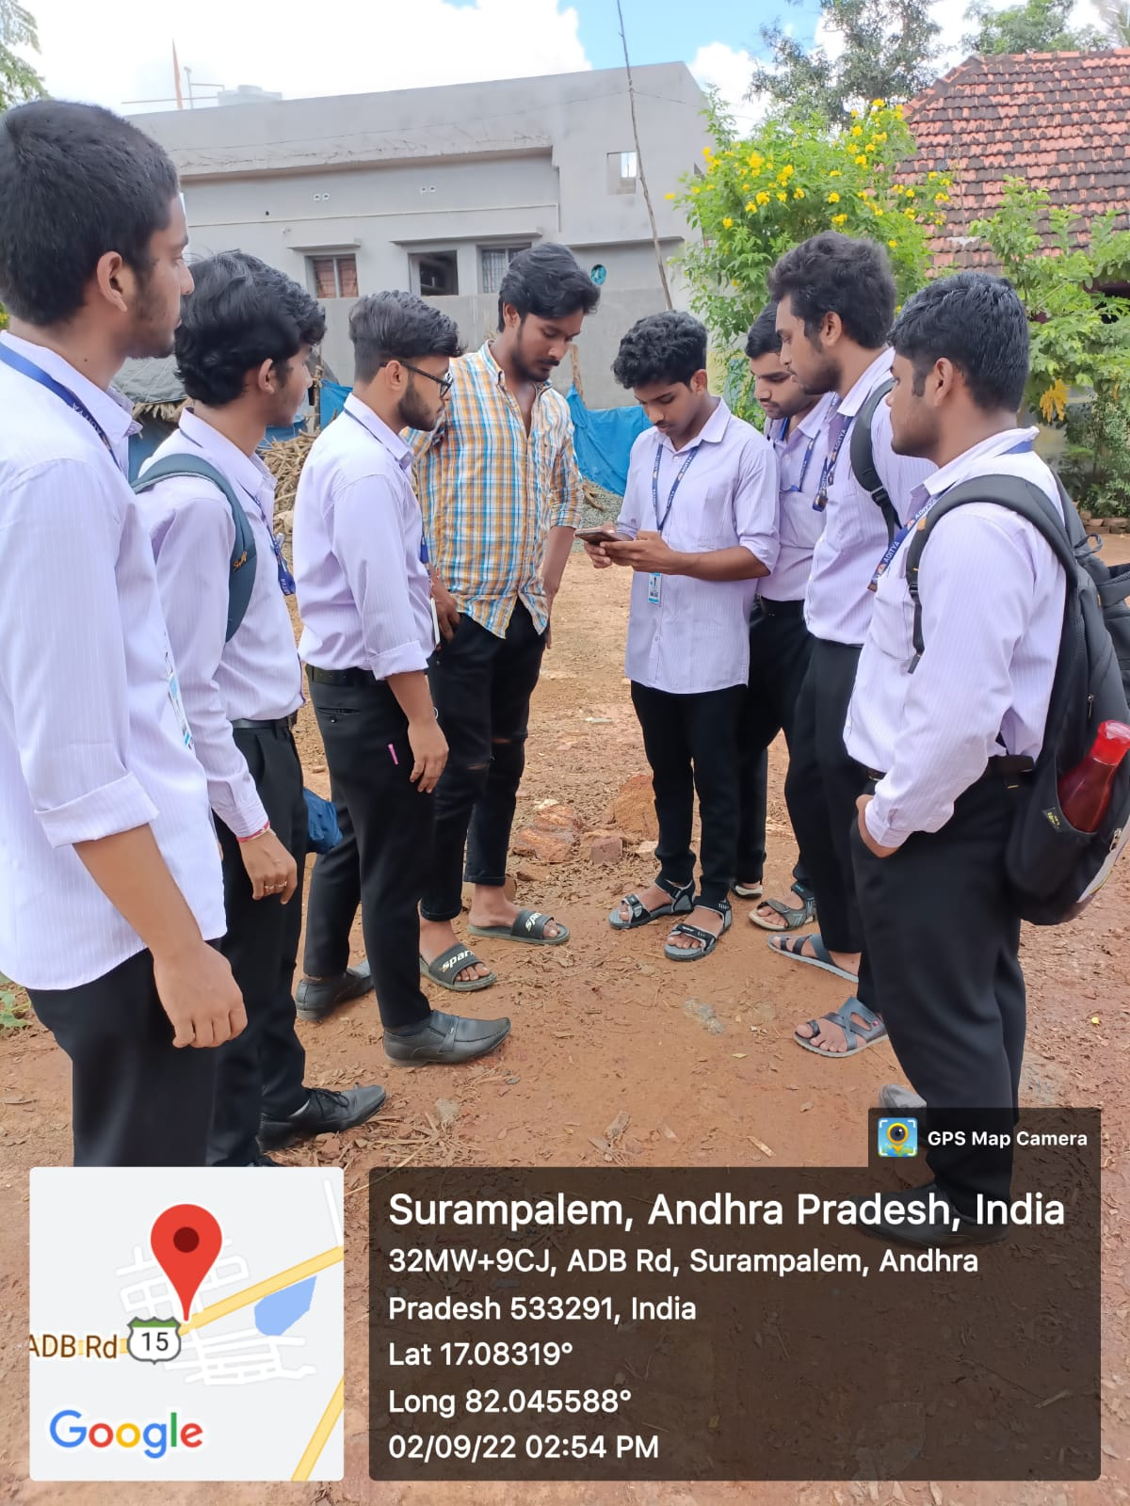
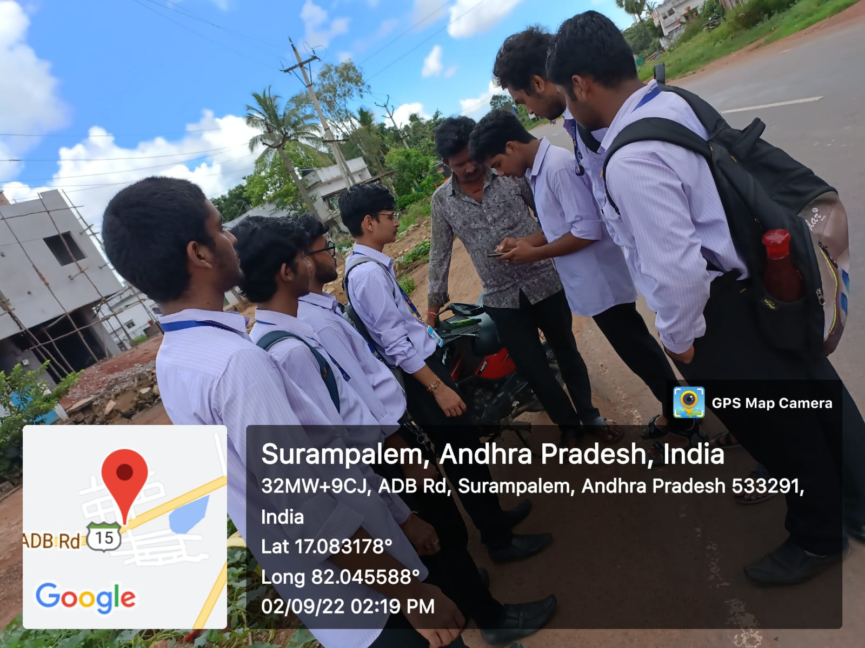
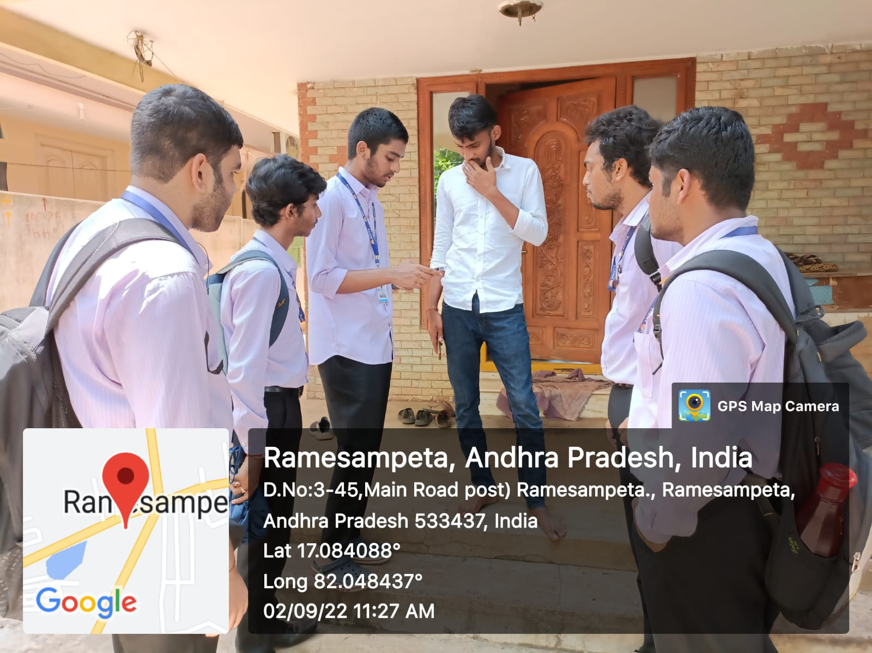
Day-4
Date-02/09/22
Visited 10 houses from 10:00AM to 12:30PM
Visited 10 houses from 02:00PM to 04:30PM

Slide 18
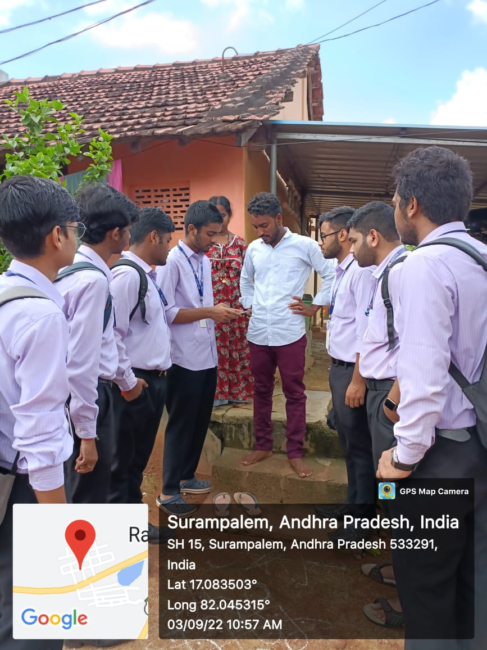
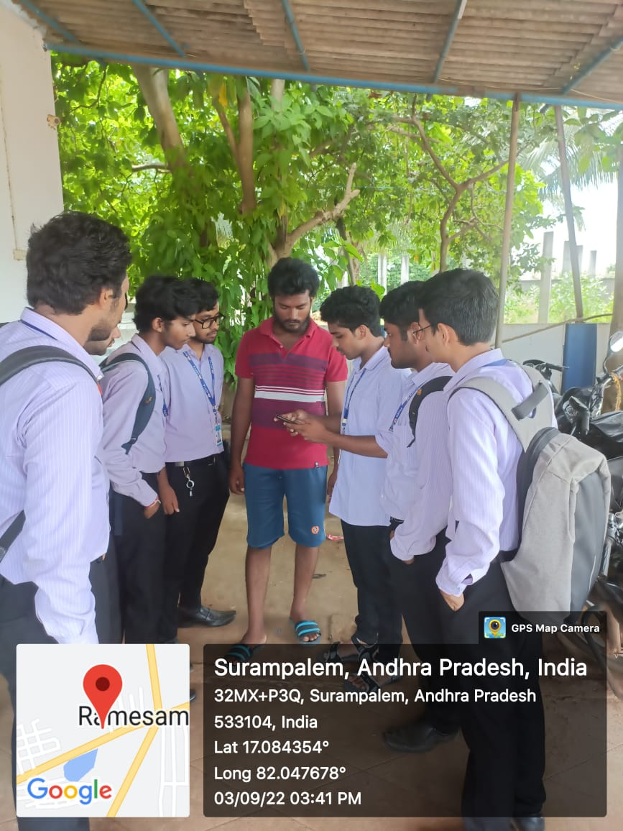
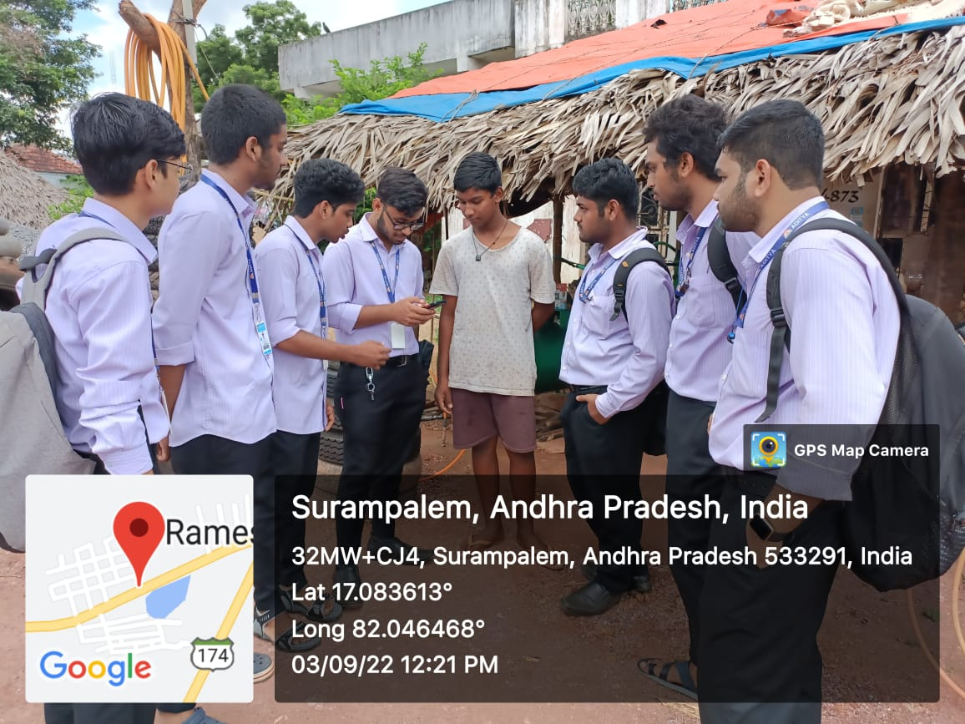
Day-5
Date-03/09/22
Visited 10 houses from 10:00AM to 12:30PM
Visited 10 houses from 02:00PM to 04:30PM

Slide 19
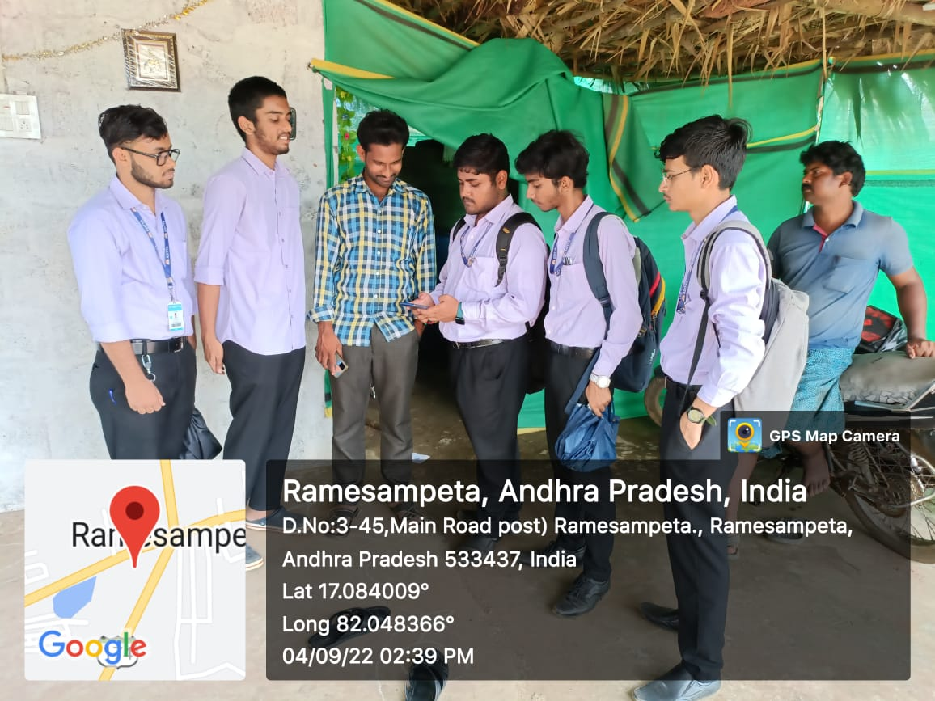
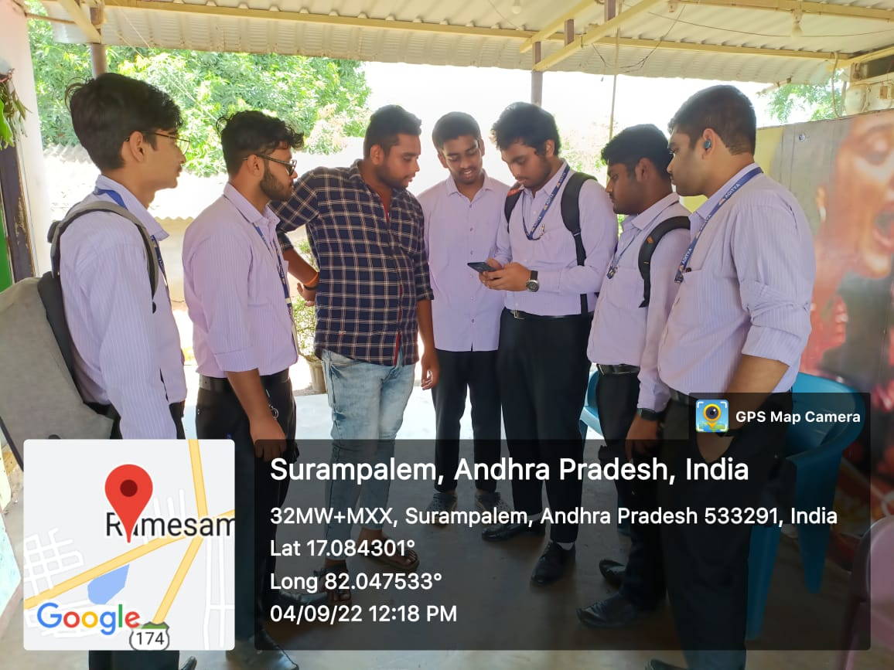
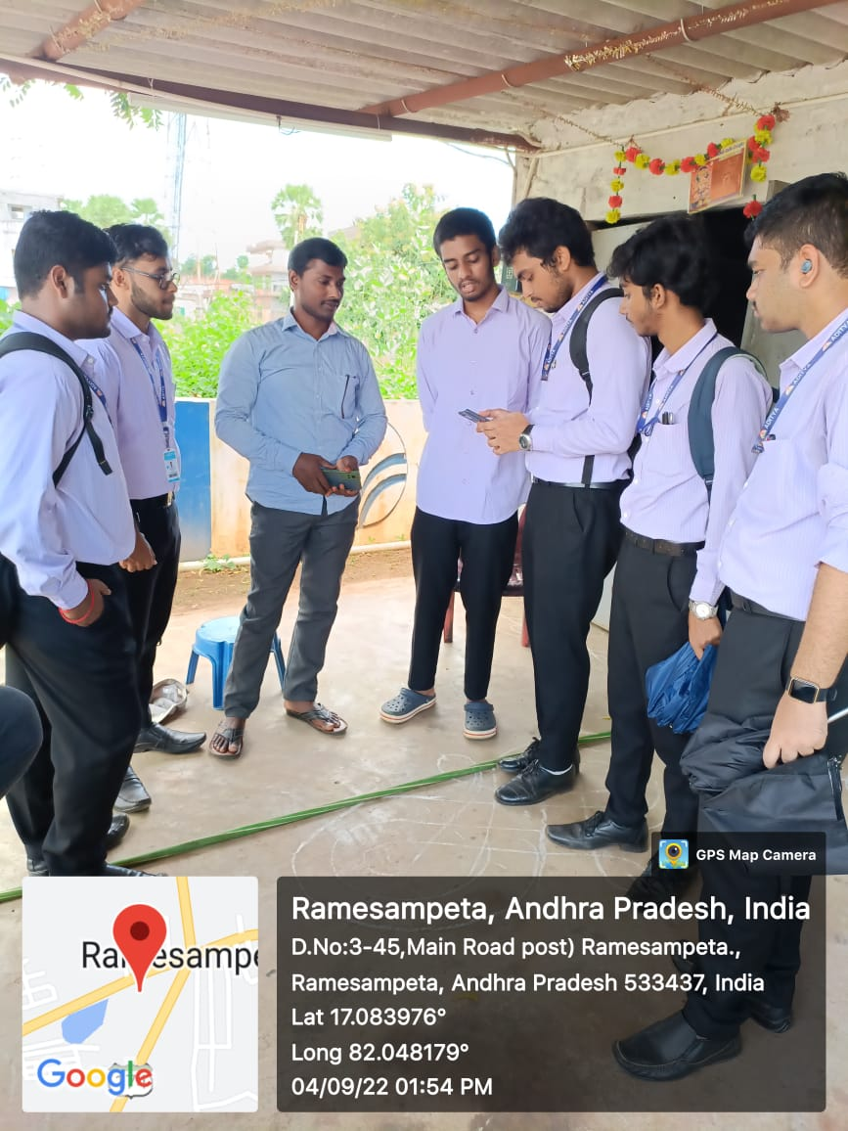
Day-6
Date-04/09/22
Visited 12 houses from 10:00AM to 12:30PM
Visited 13 houses from 02:00PM to 04:30PM

Slide 20
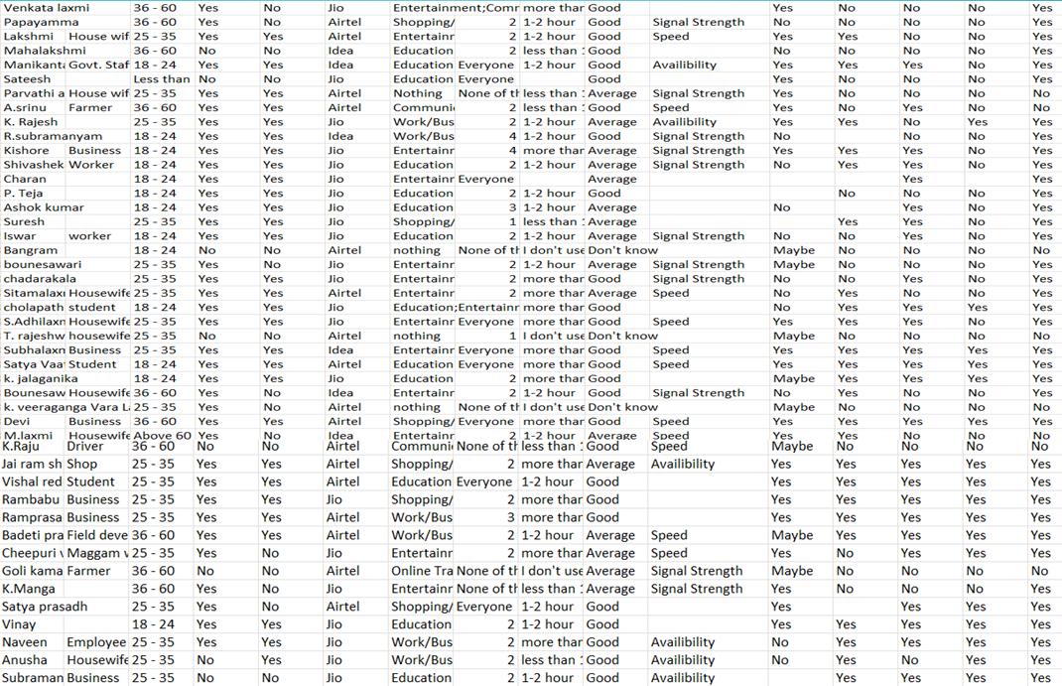
WE GOT 76 RESPONSES

Slide 21
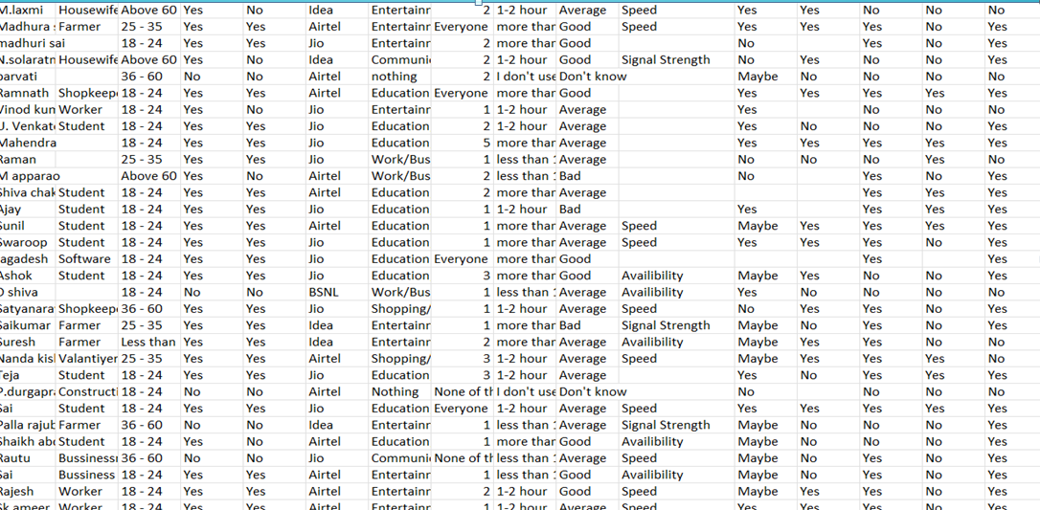
These Are The Responses We Collected During Survey…

Slide 22
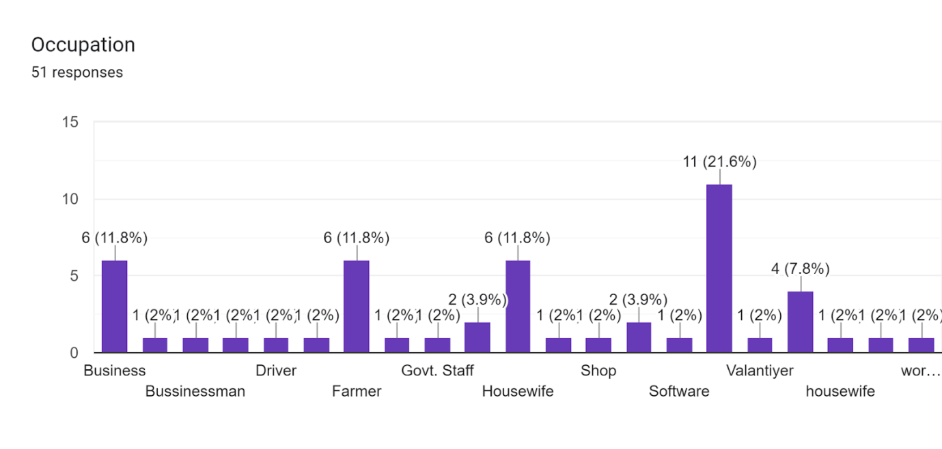
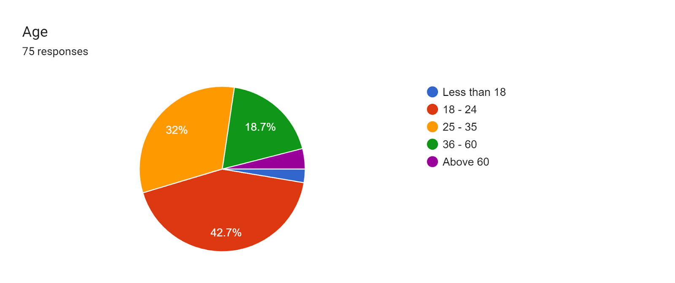
Survey Responses
OCUPATION:
EDUCATION:-21.6%(MAX)
2%(MIN)-DRIVER,SHOP,WORKER HOUSEWIFE,ETC

Slide 23
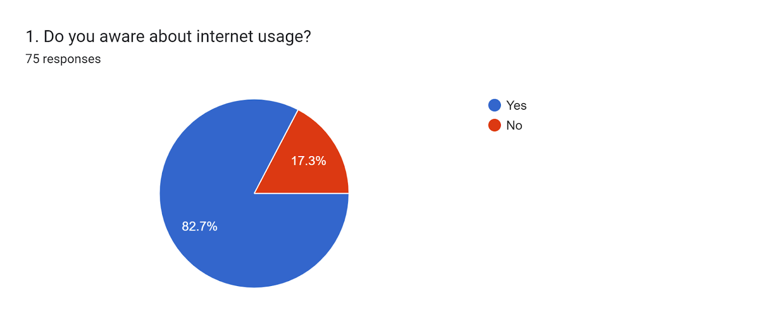
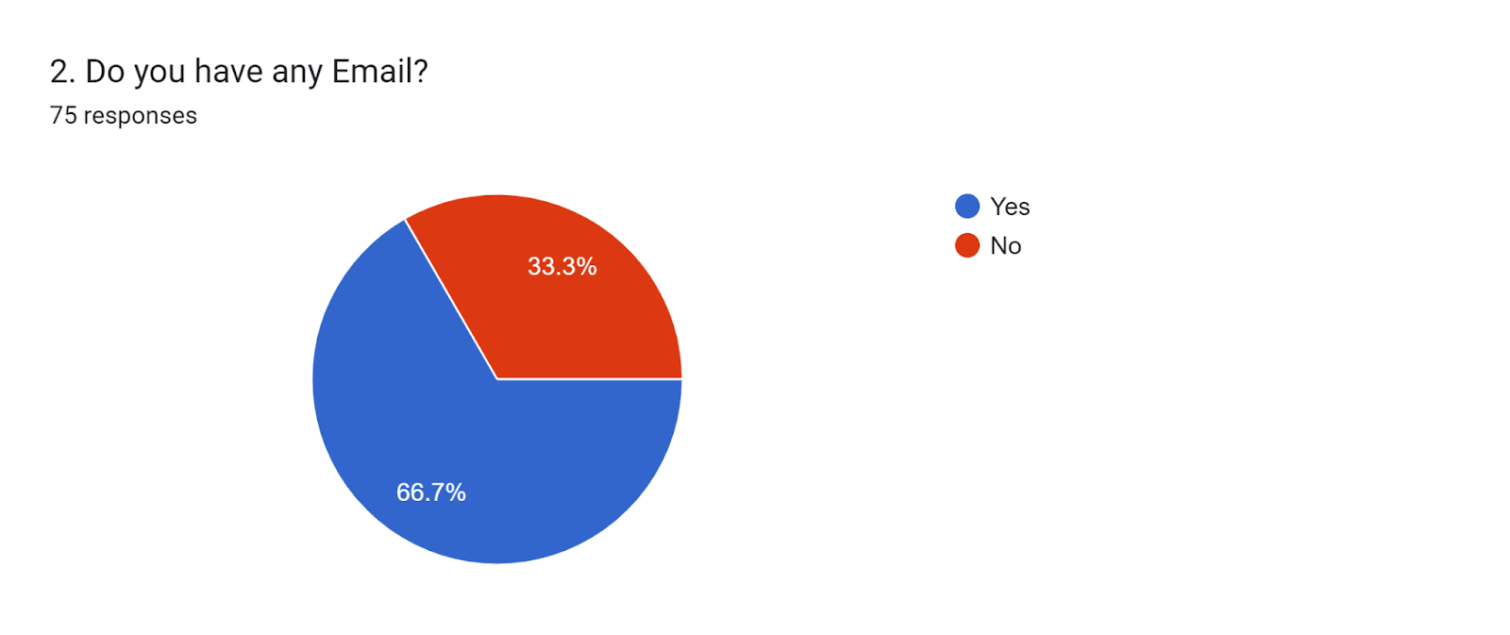

Slide 24
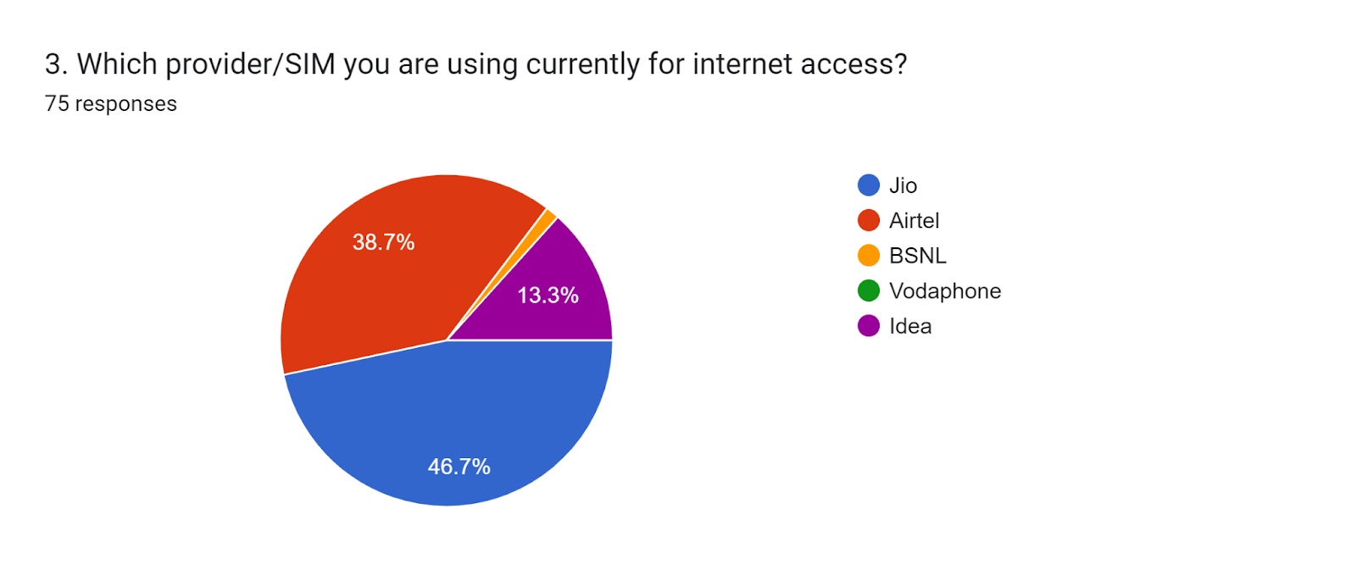
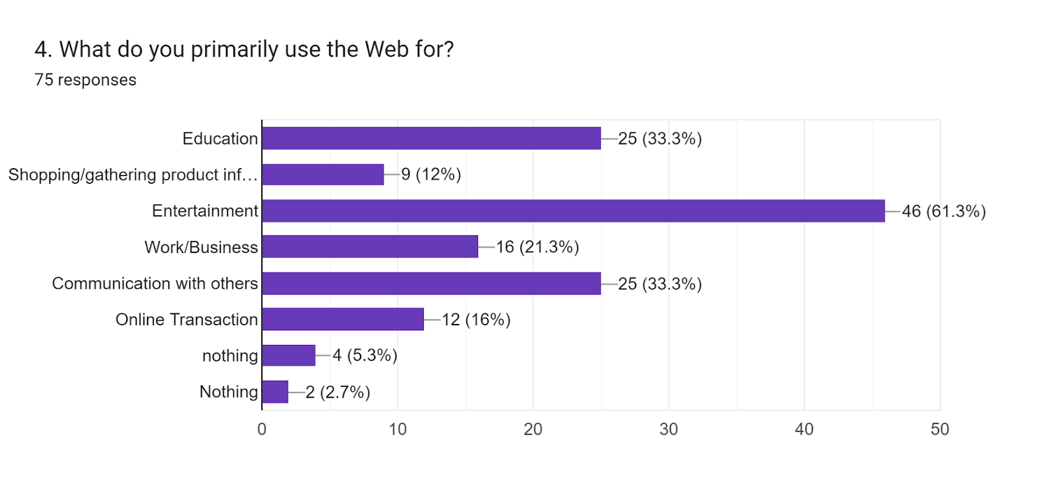

Slide 25
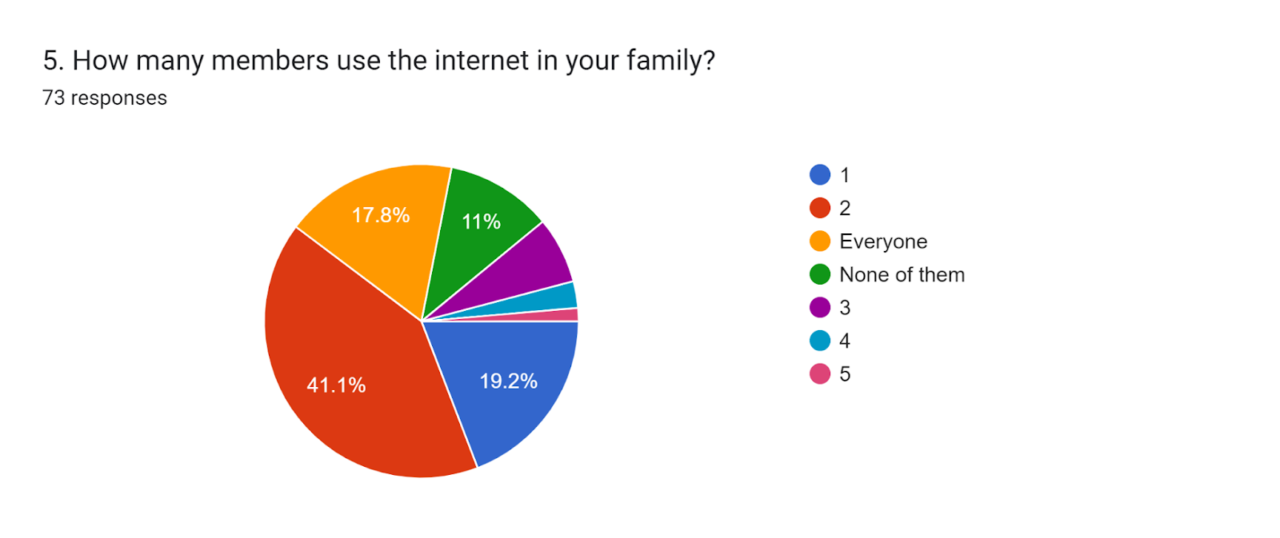
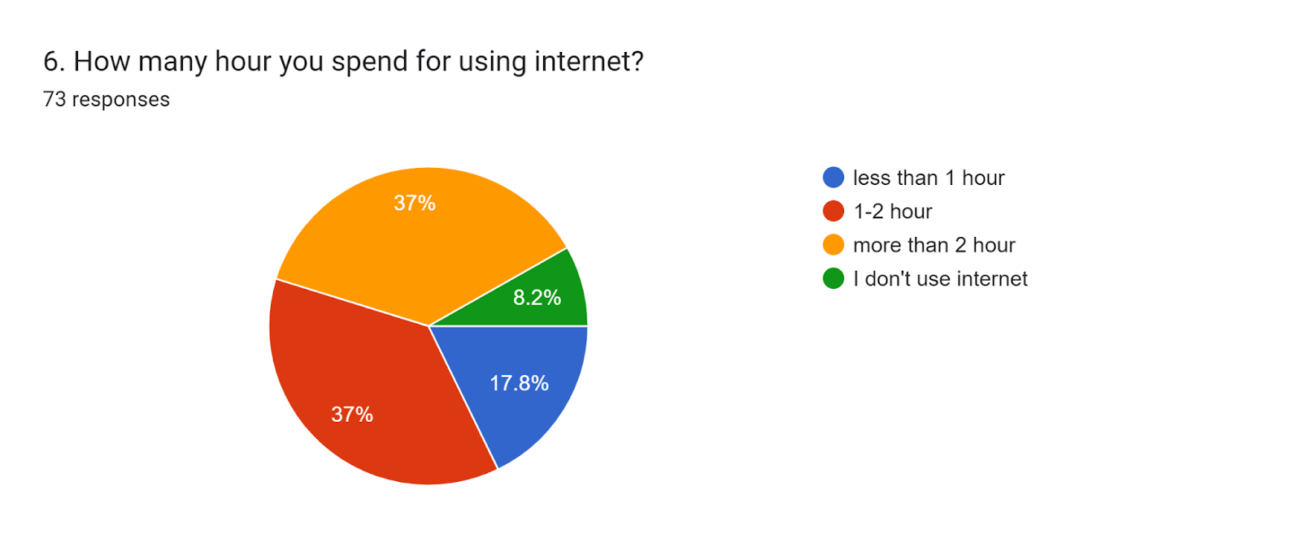

Slide 26
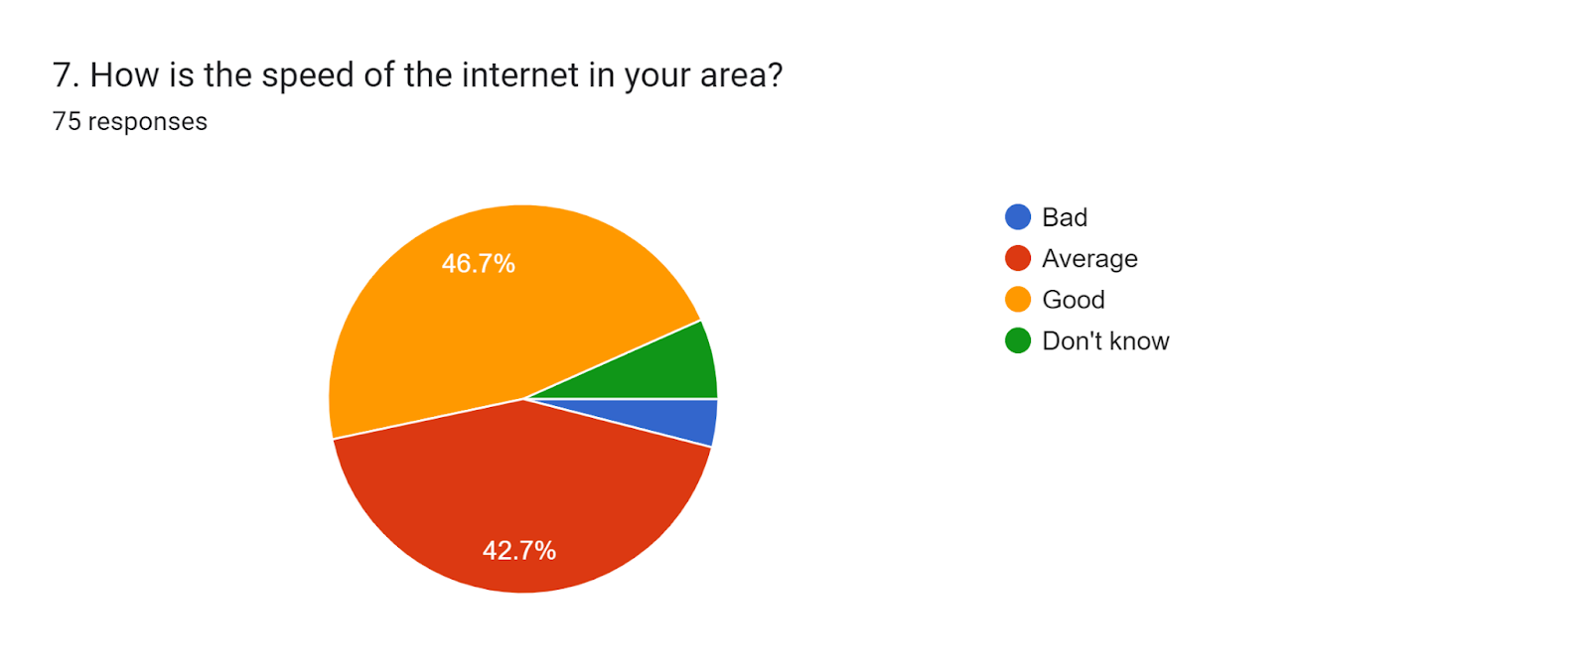
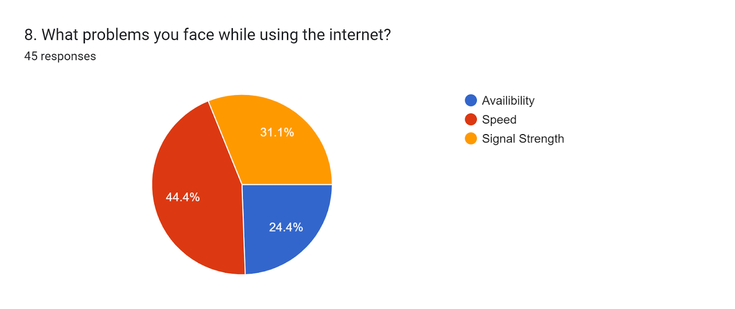

Slide 27
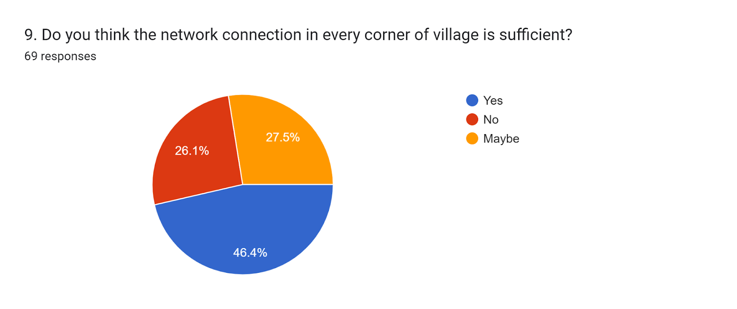
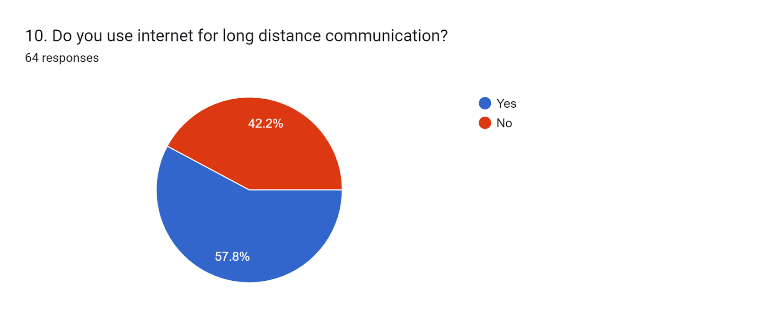

Slide 28
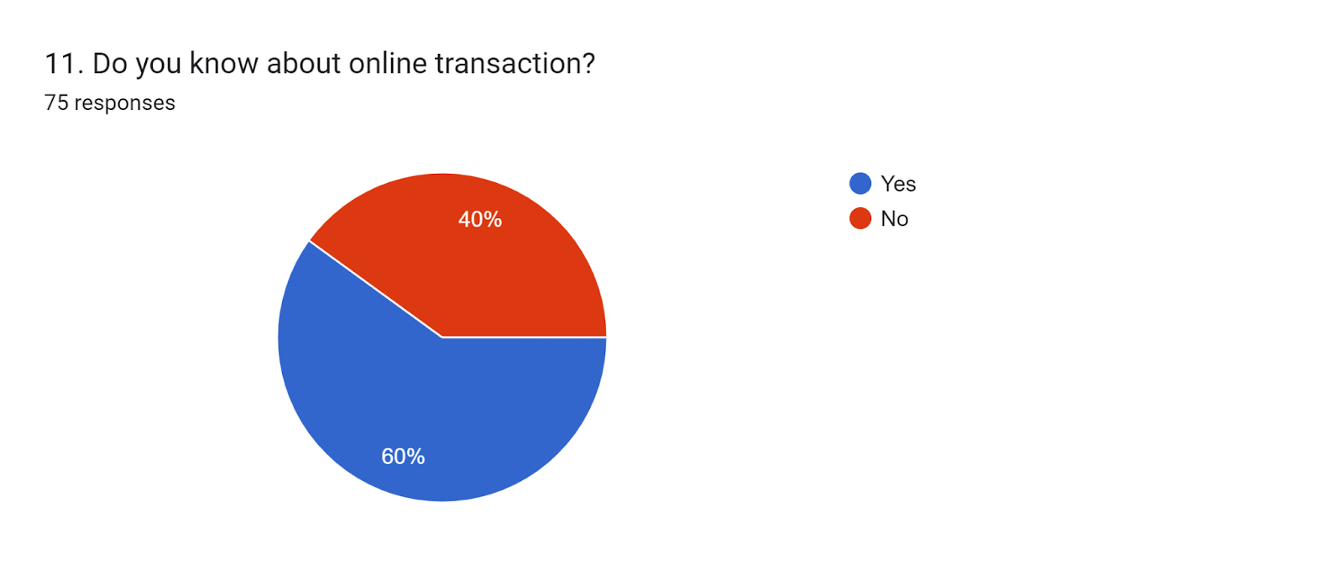
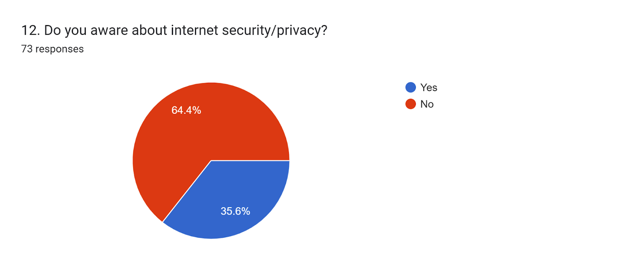
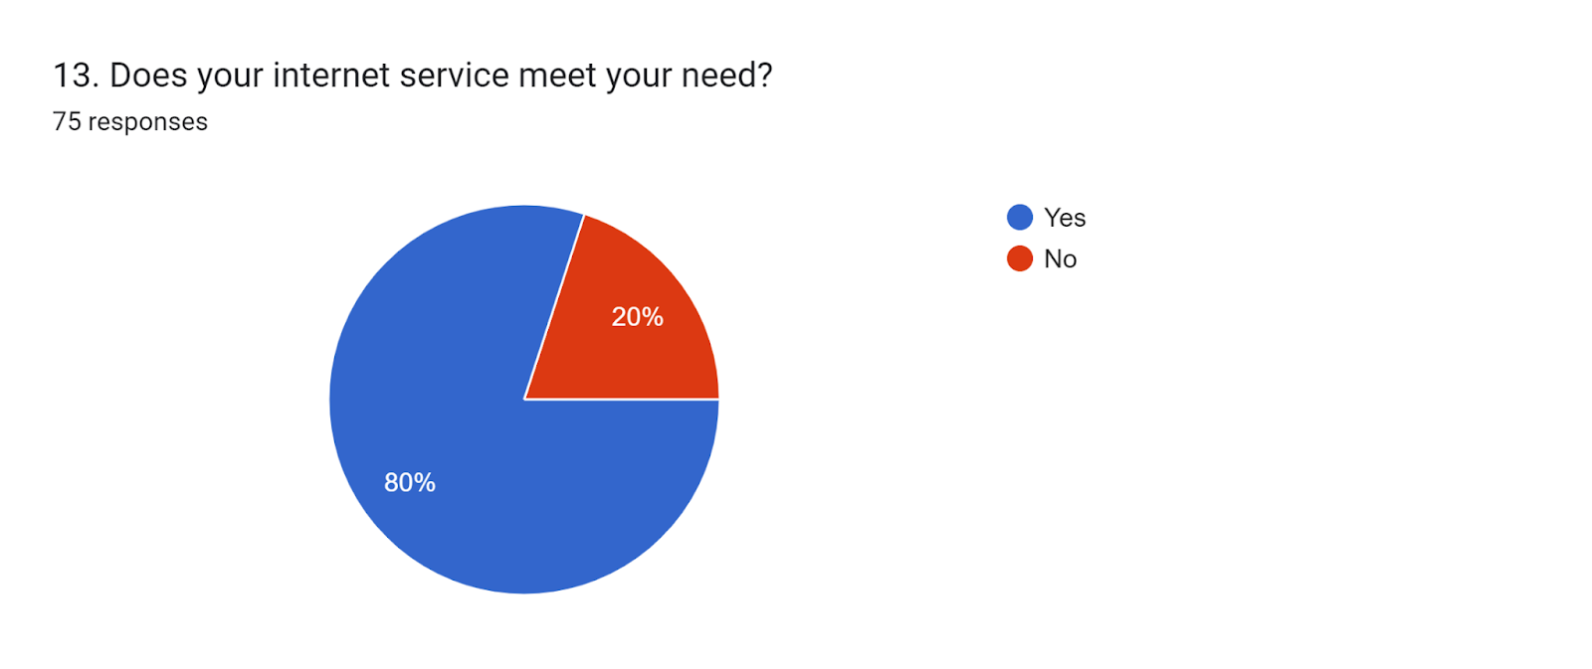

Slide 30


IDENTIFY THE PROBLEMS AND THERE SOLUTIONS
DURING THE SURVEY WE FOUND SOME NETWARK RELATED PROBLEMS SO OUR TEAM SUGGESTED FEW SOLUTIONS TO THEM

Slide 31
Problem
Most of the people using their internet more than two hour
Solution from our side
which is not good for health and also for environment. So, from our point of view using one to two hour internet is enough for all.

Slide 32
Problem
Most of the people not aware about online transaction.
Solution from our side
Now a day online transaction is more useful for all because way of payment becomes easy and no need cash in every place.

Slide 33
Problem
Most of the people not aware about internet security/privacy.
Solution from our side
In those day security is more important because threat is increasing rapidly.

Slide 34



Advantages of internet
Source of information
Entertainment
Online Shopping, e-commerce
Education
Earn money
Online Banking

Slide 35
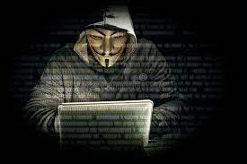
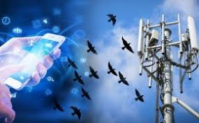

Problems faced while using internet
Internet Addiction
Cyber Crime
Spam
Health issue
Effects on birds

Slide 36
Conclusion
Internet plays an important role to become digital.
Now a days, Approximate 70-80% work is depend on internet like shopping, money transaction, … etc.
Those who are not aware about internet and what are the uses of internet and what is the importance of internet not survive confidently.
And those who are not knows about internet privacy/security definitely they face lot of problem because now a day threating rate increases day by day.
That’s why we suggest many things to them and help them to aware about internet so that they also use internet properly.

Slide 37


